Slide 1
Edge Fundamentals Bootcamp
Policy Overview

Slide 2
What is a policy ?
A policy is like a module that implements a specific, limited management function.
Edge enables you to 'program' API behavior without writing any code, by using 'policies'.
Policies are designed to let you add common types of management capabilities to an API easily and reliably.
Policies provide features like security, rate-limiting, transformation, and mediation capabilities - saving you from having to code and maintain this functionality on your own.
Edge's out-of-the-box policies enable you to augment your API with sophisticated features to control traffic, enhance performance, enforce security, and increase the utility of your APIs, without requiring you to write any code or to modify any backend services.
Extension policies enable you to implement custom logic in the form of JavaScript, Python, Java, and XSLT.

Slide 3
Out of the box policies
Traffic management policies | Mediation policies | Security policies | Extension policies
Cache policies Concurrent Rate Limit policy Quota policy Reset Quota policy Spike Arrest policy | Access Entity policy Assign Message policy Extract Variables policy JSON to XML policy Key Value Map Operations policy Raise Fault policy SOAP Message Validation policy XML to JSON policy XSL Transform policy | Access Control policy Basic Authentication policy JSON Threat Protection policy LDAP policy *† OAuth v2.0 policies OAuth v1.0a policy Regular Expression Protection policy SAML Assertion policies Verify API Key policy XML Threat Protection policy | Java Callout policy * JavaScript policy Message Logging policy Python Script policy * Service Callout policy Statistics Collector policy * Cloud Enterprise only † On-Premises installation only
Notes:
The policy schemas, available in Github, provide the full set of elements and attributes available for policy configuration. - https://github.com/apigee/api-platform-samples/tree/master/schemas/policy

Slide 4
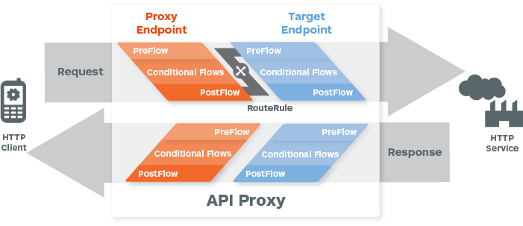
Enable fine grain controls in the API proxy
Many different points where policies can be configured to execute
Notes:
Main Point
Apigee Edge enables you to precisely control the API flow from client to the backend
Script
Edge provides precise control of an API proxy flow by segmenting each part of the flow, including default and non-default paths as well as pre-flow and post-flow for both the request and response. This capability enables you to maximize inter-API code reuse with preflow / postflow, maximize code reuse via custom flows for related resources, optimize the response with multiple flows, and optimize for the client platform with multiple flows
Link to Wiki
https://apigeesc.atlassian.net/wiki/pages/viewpage.action?pageId=76415413
For Instance
None

Slide 5
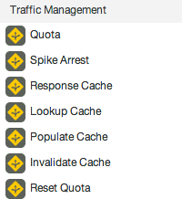
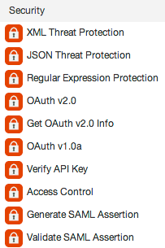
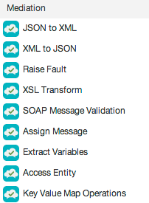
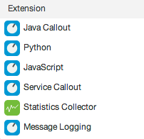
Build APIs faster to help..
Manage interactions with API consumers and optimize performance
Secure APIs and protect back-end systems from attack
Transform, translate and reformat data for easy consumption
Extend with programming when you need it
Notes:
Main Point
Apigee Edge includes over 30 easy to configurable policies and built in support for Node, JavaScript and Java extensibility
Script
Apigee Edge includes over 30 easy to configurable policies AND built in support for Node, JavaScript and Java extensibility
APIs developed with Edge can leverage the out-of-the-box, configurable policies, custom code written in JavaScript (Node.js) or Java, or both. The flexibility to leverage standard implementations, configuration AND code improves developer productivity by accelerating the time to solve both common and complex problems.
Common themes and use cases, are best handled with standard implementations and configuration. Apigee Edge provides Traffic Management, Security, Mediation and other policies out of the box that you can leverage, configure, and reuse across projects. These policies provide common, consistent, scalable, tuned implementations of common functionality.
Complex problems are best handled via software development, or a combination of configuration and development. Apigee Edge enables you to solve these complex or unique needs through extension polices. You can write these extension policies in JavaScript, Java, node.js, or external services.
In addition, with our micro-services architecture, you can implement a set small, independent, decoupled, focused processes with node.js and deploy them in the gateway to meet your unique needs.
Whether your needs are simple or complex, Apigee Edge provides you the flexibility you need to build APIs faster.
Link to Wiki
https://apigeesc.atlassian.net/wiki/display/SEP/API+Development+with+Configuration+and+Code
For Instance
None

Slide 6
Traffic Management

Slide 7
Spike Arrest
Help protect your API proxy’s target backend against severe traffic spikes and denial of service attacks
Used to control requests by the second and minute
Typically used in the “preflow”
http://docs.apigee.com/api-services/reference/spike-arrest-policy

Slide 8
Quota
Used to limit number of requests over a period of time such as a minute, hour, day, week, or month.
Could be the same limit for everyone, or configure based on product, developer, etc
Typically used in the “preflow”
http://docs.apigee.com/api-services/reference/quota-policy
“Reset Quota” is used to reset the quota during the request
http://docs.apigee.com/api-services/reference/reset-quota-policy

Slide 9
Response Cache
Used to cache the whole HTTP response (including body, headers, status code, etc)
Response Cache policy can improve performance by retrieving response from the cache instead of back end
Policy attached in both the request and response flows
Typically only used with GET calls
http://docs.apigee.com/api-services/reference/response-cache-policy

Slide 10

Cache
Used to cache specific pieces of data within the proxy
Examples of using cache:
tokens, service callout responses, data from previous calls, etc
Use the “populate”, “lookup” and “invalidate” policies to control the cache
http://docs.apigee.com/api-services/reference/populate-cache-policy
http://docs.apigee.com/api-services/reference/lookup-cache-policy
http://docs.apigee.com/api-services/reference/invalidate-cache-policy
http://docs.apigee.com/api-services/reference/working-cachekeys

Slide 11
Mediation

Slide 12

JSON to XML, XML to JSON
Used to convert a JSON payload to XML or an XML payload to JSON
Convenient if the backend is XML and a JSON REST API is needed
There are several “out of the box” types of conversion available
Policy can be used at any point in the proxy
http://docs.apigee.com/api-services/reference/json-xml-policy
http://docs.apigee.com/api-services/reference/xml-json-policy

Slide 13
Raise Fault
Raises a “fault” in a proxy
A technique to force the execution of FaultRules
Could also be used to send an error response back to the client
Policy can be used at any point in the proxy
http://docs.apigee.com/api-services/reference/raise-fault-policy
http://docs.apigee.com/api-services/content/fault-handling

Slide 14
XSL Transform
Applies a custom XSLT to an XML payload
This allows the transformation to another format such as XML, HTML, etc
Policy can only be used if the “Content-Type” is XML
Policy can be used at any point in the proxy
http://docs.apigee.com/api-services/reference/xsl-transform-policy

Slide 15
SOAP Message Validation
Used to validate an XML message against an XSD schema
Validate SOAP messages against a WSDL
Confirm message is well-formed
Policy can be used at any point in the proxy
http://docs.apigee.com/api-services/reference/message-validation-policy

Slide 16
Assign Message
Creates or modifies HTTP request or response messages
Used to modify the request message before it is sent to the back end
Used to modify the response message before it is sent to the client
Used to create/modify custom request/response objects for a Service Callout policy
Used to create and modify flow variables
Policy can be used at any point in the proxy
One of the most used policies
http://docs.apigee.com/api-services/reference/assign-message-policy

Slide 17
Extract Variables
Used to extract data from a variable
Often, that variable is the HTTP Request or Response
Headers, URI paths, form/query parameters, JSON/XML payloads can be extracted using this policy
Use a text pattern to extract the data
Policy can be used at any point in the proxy
One of the most used policies
http://docs.apigee.com/api-services/reference/extract-variables-policy

Slide 18
Access Entity
Retrieves entity profiles configured in Edge
Use this policy to retrieve metadata from:
App
API Product
Company
Company developer
Consumer Key
Developer
Policy can be used at any point in the proxy
http://docs.apigee.com/api-services/reference/access-entity-policy

Slide 19
Key Value Map (KVM)
Provides access to a Key Value Map store in Edge
Supports PUT, GET, DELETE operations
The creation of the KVM is done in a different step
Management UI (APIs → Environment Configuration)
Management API
Policy can be used at any point in the proxy
http://docs.apigee.com/api-services/reference/key-value-map-operations-policy

Slide 20
Security

Slide 21
Basic Authentication
Provides encoding and decoding to use for Basic Authentication
Will base64 encode a username and password for backend authentication
Will base64 decode the Authorization header to retrieve username and password for validation
Policy can be used at any point in the proxy
http://docs.apigee.com/api-services/reference/basic-authentication-policy

Slide 22

XML, JSON, Regex Threat Protection
These policies provide an easy way to inspect the payload coming in (from a POST) or from a backend response from threats
The XML and JSON policies will validate the message structure meets predefined standards
The Regex threat protection will evaluate the payload against predefined regular expressions (ex: SQL injection)
Policy can be used at any point in the proxy
http://docs.apigee.com/api-services/reference/xml-threat-protection-policy
http://docs.apigee.com/api-services/reference/json-threat-protection-policy
http://docs.apigee.com/api-services/reference/regular-expression-protection

Slide 23
Verify API Key
This policy will enforce verification of the API key at runtime
The purpose is to restrict access to your API to only those with a valid API Key
The key is created when a Developer App is created with a specific API Product
The API Key can be passed in through the header or as a query parameter
Policy can be used at any point in the proxy
http://docs.apigee.com/api-services/reference/verify-api-key-policy

Slide 24

OAuth v1.0a
These policies are used to support OAuth v1.0a
Actions supported:
Generating a request token and an access token, associate token verification code with a request token, verifying an access token, customize an access token
Policy can be used at any point in the proxy
These policies are rarely used because OAuth v1.0a has been replaced by OAuth v2.0
http://docs.apigee.com/api-services/reference/oauth-10-policy
http://docs.apigee.com/content/retrieve-token-attributes-using-getoauthv1info
http://docs.apigee.com/api-services/content/delete-oauth-v1-info

Slide 25
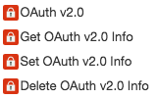
OAuth v2.0
These policies are used to support OAuth v2.0a
Actions supported:
Generate Access Token, Verify Access Token, Generate Authorization Code, Refresh Access Token
Retrieve additional metadata related to the access token or authorization code
Policy can be used at any point in the proxy
These policies are rarely used because OAuth v1.0a has been replaced by OAuth v2.0
http://docs.apigee.com/api-services/content/oauthv2-policy
http://docs.apigee.com/api-services/reference/get-oauth-v2-info-policy
http://docs.apigee.com/api-services/reference/set-oauth-v2-info-policy
http://docs.apigee.com/api-services/content/delete-oauth-v2-info
http://docs.apigee.com/api-services/content/oauth-home

Slide 26
Access Control Policy
This policy empowers the developer to allow or deny access based on IP addresses
The following configurations are supported:
Allow or Deny Specific IP Address
Allow or Deny Multiple IP Address
Allow or Deny IP Addresses using basic matching rules
Policy can be used at any point in the proxy
http://docs.apigee.com/api-services/reference/access-control-policy

Slide 27

SAML
This policy allows the support of SAML in the proxy
The validate policy is used to validate a SAML assertion that is attached to an inbound XML message
The generate policy is used to generate and attach a SAML assertion to an outbound XML message
Policy can be used at any point in the proxy
http://docs.apigee.com/api-services/reference/saml-assertion-policy

Slide 28
Extension

Slide 29
Javascript Callout
This policy allows custom Javascript code to execute within the context of an API proxy flow
The “context” object provides runtime access to the current context of the flow
There is a built-in Javascript object model available
Policy can be used at any point in the proxy
This is a commonly used policy
http://docs.apigee.com/api-services/reference/javascript-policy
http://docs.apigee.com/api-services/reference/javascript-object-model

Slide 30
Python Callout
This policy allows custom Python code to execute within the context of an API proxy flow
The “flow” variable provides runtime access to the current context of the flow
Best used for existing custom Python code
Policy can be used at any point in the proxy
It is recommended to use a Javascript policy where possible
http://docs.apigee.com/api-services/reference/python-script-policy

Slide 31
Java Callout
This policy allows custom Java code to execute within the context of an API proxy flow
The java code must be compiled and packaged as a jar file and then uploaded into the proxy
It must follow the guidelines as specified in the documentation
Policy can be used at any point in the proxy
This is only available on a paid org or on-prem
http://docs.apigee.com/api-services/reference/java-callout-policy

Slide 32
Service Callout
This policy allows another service to be called from the API proxy flow
Calls can be made to an external or internal service
Using the “AssignMessage” policy, a new request message can be created for this policy
Using the “ExtractVariables” policy, the response can be parsed
Policy can be used at any point in the proxy
http://docs.apigee.com/api-services/reference/service-callout-policy

Slide 33
Flow Callout
This policy calls out to a “shared flow” from a proxy or another shared flow
The “shared flow” must first be created and deployed
Shared flows can call other shared flows
Policy can be used at any point in the proxy
http://docs.apigee.com/api-services/reference/flow-callout-policy
http://docs.apigee.com/api-services/content/shared-flows

Slide 34
Statistics Collector
This policy enables the developer to collect statistics based on data in the message.
The data can come from flow variables or custom variables that have been defined by previous policies.
The data is processed by the analytics service and will appear in the analytics reports.
When creating an analytic report, the custom stats data will be available to select.
Policy can be used at any point in the proxy
http://docs.apigee.com/api-services/reference/statistics-collector-policy

Slide 35
Message Logging
This policy allows custom logging features
For cloud, the policy will gather data and send to a logging service asynchronously
For onprem, the policy can be configured to log custom messages to the local file system
Policy can be used at any point in the proxy
http://docs.apigee.com/api-services/reference/message-logging-policy

Slide 36
THANK YOU

